Slide 1

Event Management System
Presented by: Zain Tahir (FA23-BCE-111),
Shehryar Arif (FA23-BCE-102)
Presented to: Dr. Mahmood Qureshi
Submission Date: 23/12/2024
Course Name: Software Engineering
Course Code: CSC-291

Slide 2
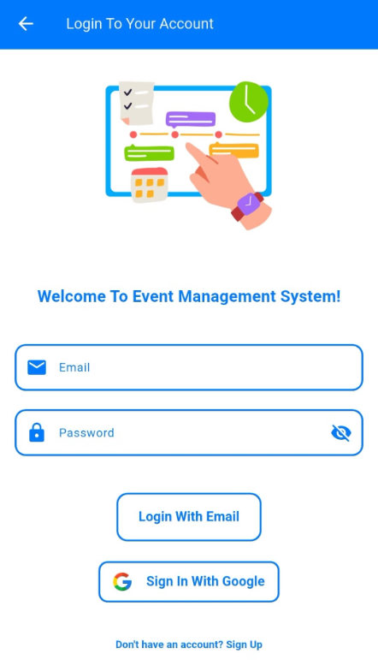
Project Overview
Introduction:
The Event Management System is a comprehensive Flutter app designed to simplify event organization and ticketing. It features a user-friendly interface that streamlines event creation, registration, and ticket sales for both organizers and attendees.
Key Objectives:
Key features include a customizable registration system, secure ticketing with payment gateway integration, and a real-time reporting dashboard for tracking key metrics.
Seamless and intuitive event management for all users.
Enhanced security and real-time data updates via Firebase.
Excellent accessibility with dynamic theming and responsive UI.
Integrated Gemini-powered chatbot for instant support.

Slide 3
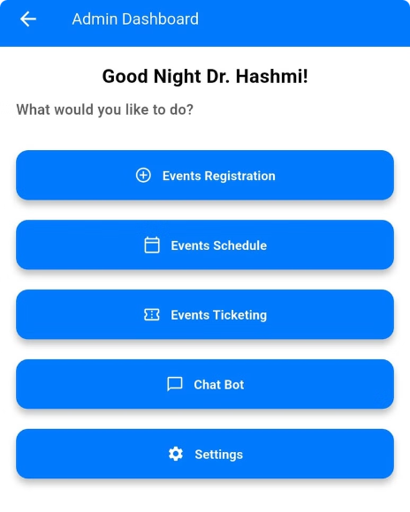
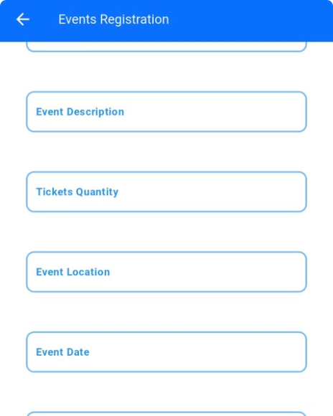
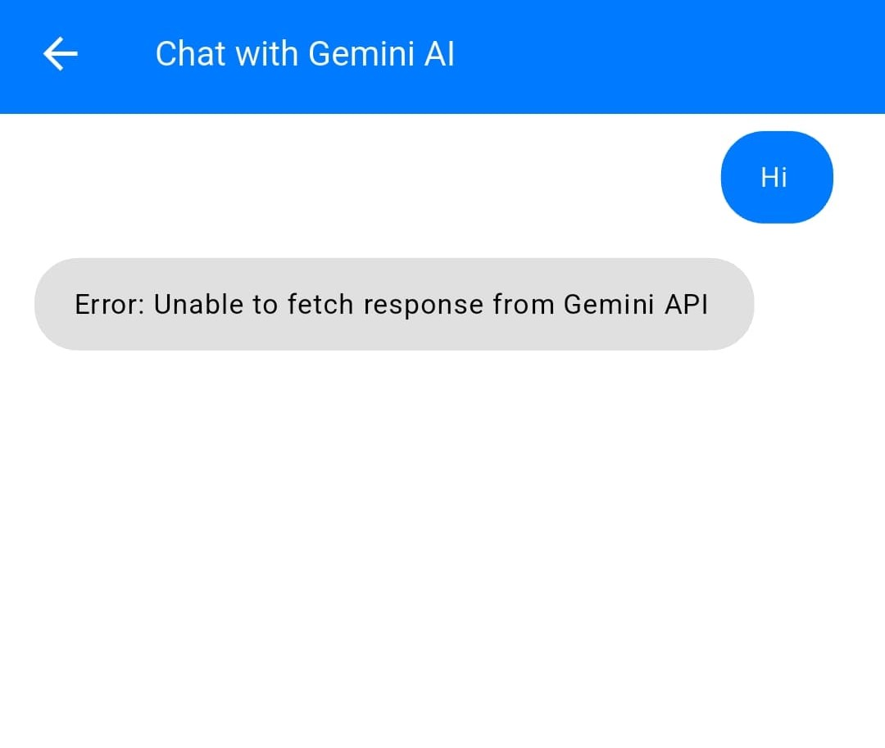
Explore the Event Management System
Admin Dashboard
Event Listing
Chatbot Integration
Admins have complete control over event creation, schedule management, and ticket monitoring, making event organization efficient and streamlined.
Users can easily browse events, filter by category, and access detailed information including dates, times, and ticket availability.
A powerful Gemini-powered chatbot provides 24/7 assistance, answering questions about events, ticket purchase, and general information.

Slide 4
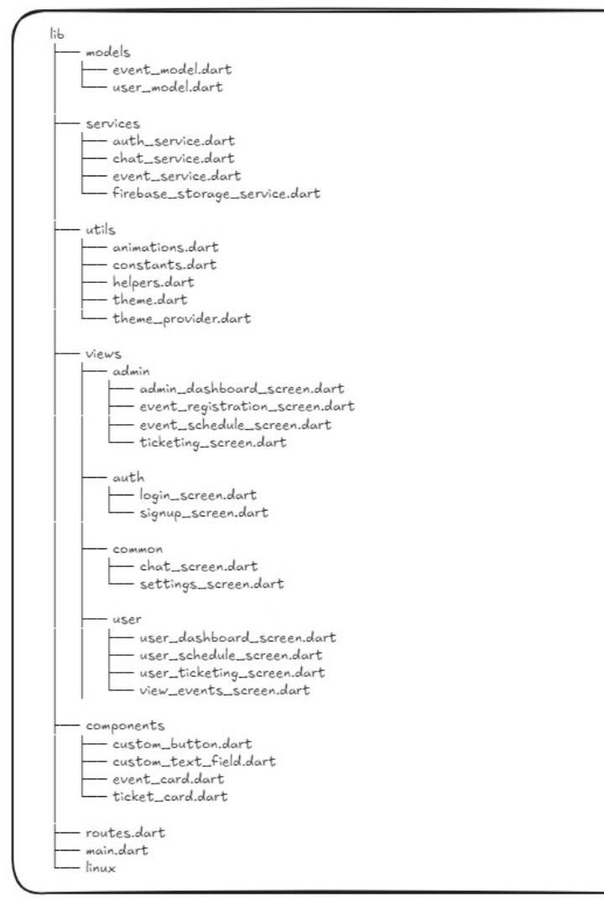
Project Management Evolution
1
We adopted an Agile methodology to manage the development process, focusing on iterative sprints and continuous improvements based on feedback.
This allowed us to quickly adapt to changing requirements and ensure the project remained on track.
2
Key Milestones:
Sprint 1: Authentication and role-based dashboards.
Sprint 2: Chatbot and event scheduling features.
Sprint 3: Dark mode and UI enhancements.

Slide 5
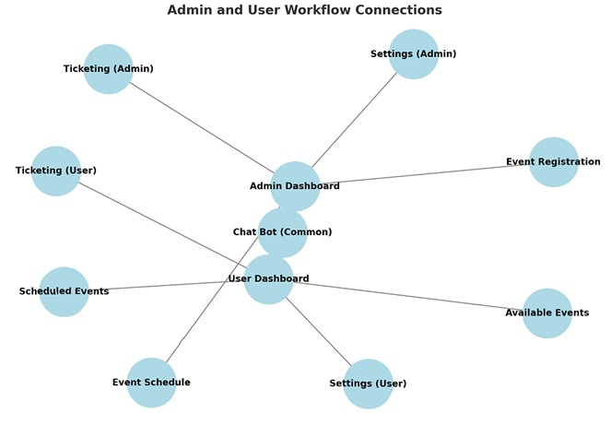
Agile Practices and Benefits
1
Iterative Development
2
Sprint Retrospectives
We followed iterative cycles of planning, developing, testing, and refining, ensuring continuous improvement throughout the project.
Regular retrospectives allowed us to identify and resolve bottlenecks, improving efficiency and preventing delays.
3
Flexibility and Adaptability
The Agile methodology allowed us to adapt to stakeholder feedback
and new requirements, ensuring the app met user needs.

Slide 6
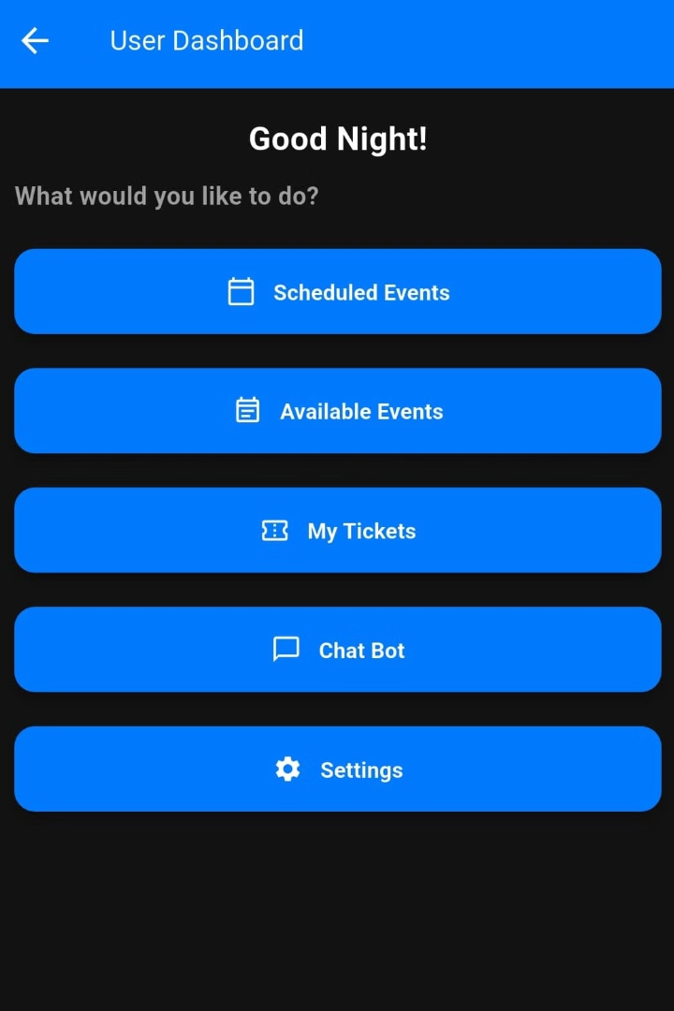
The Role of Stakeholder Feedback
UI Accessibility
Firebase Integration
We incorporated feedback to improve UI accessibility, enhancing the user experience for a broader audience.
Stakeholder feedback led to a transition to Firebase, offering secure and scalable data storage for our app.
Dark Mode and Chatbot
User testing helped us refine the dark mode functionality and chatbot interactions, improving their usability and effectiveness.

Slide 7
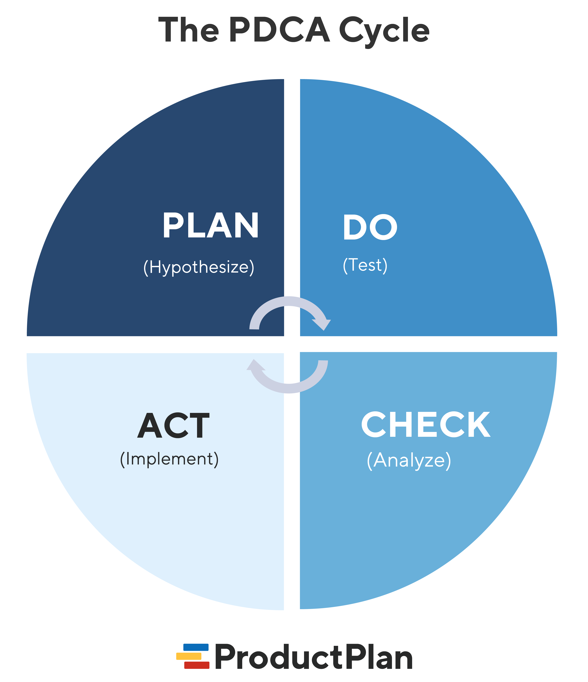


Continuous Refinement Through Feedback
Challenges
Resolutions
Challenges encountered during development included Firebase setup, dark mode transitions, and local storage limitations.
We addressed these challenges through early prototyping, adopting the PDCA cycle for continuous improvement, and migrating from local storage to Firebase.

Slide 8
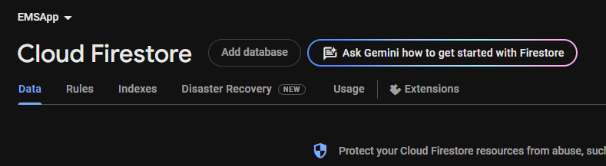

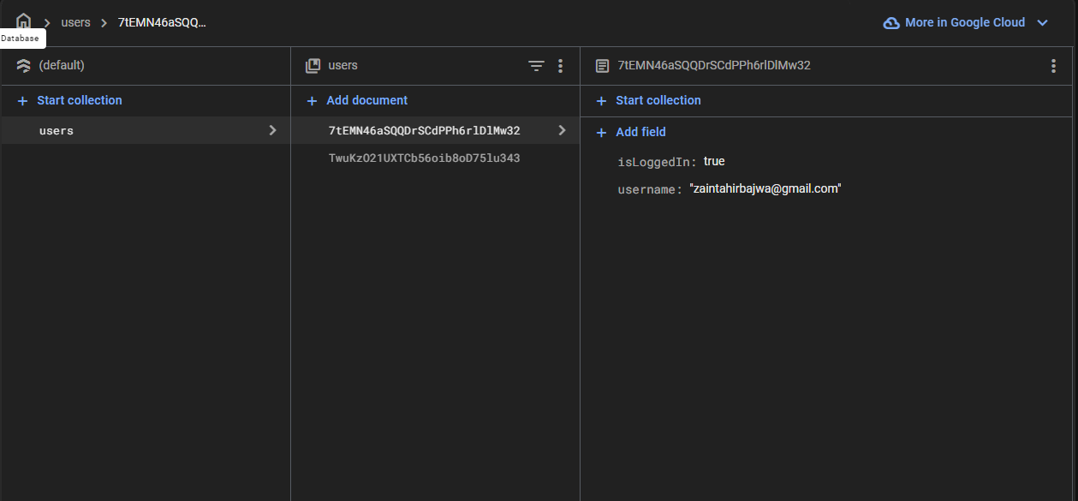

Ensuring Quality and Reliability
Our quality assurance process involved a multi-faceted approach, ensuring the app's functionality, reliability, and user experience.
We conducted unit tests for functions like login and ticket booking, integration tests for seamless interactions between modules, and UI tests for responsiveness.
Tools Used:
Flutter DevTools for comprehensive debugging and analysis.
Firebase Test Lab for automated testing and performance evaluation.

Slide 9





Outcomes and Takeaways
1
Key Achievements
Fully Implemented Features
2
All features, including event registration, ticketing, chatbot interaction, and dark mode, were successfully implemented.
3
Secure Data Handling
Firebase integration ensured secure and scalable data storage for user information and event data.
4
Positive User Feedback
User testing revealed positive feedback on the app's usability, particularly the chatbot's helpfulness.
5
Lessons Learned
The project emphasized the importance of adaptability, early prototyping, and continuous feedback for successful development.

Slide 10
What’s Next?
1
Recommendations
CI/CD Pipelines
2
Adopting CI/CD pipelines will streamline the development workflow, enabling faster deployment and updates.
Research and Prototyping
3
Allocating more time for research and prototyping will enable us to explore innovative features and improve the app's functionality.
Chatbot Expansion
4
Expanding the chatbot's capabilities based on user needs will enhance its usefulness and provide more comprehensive assistance.
Future Vision
5
We envision extending the app's functionality to include event notifications, user analytics, and personalized recommendations.

